Slide 1
Southern Border Conference
RTME, POA, & Broker Compliance in Evolving Enforcement
October 25, 2026

Slide 2


Agenda
Topics for discussion…
Current Climate
Power of Attorney Recap
Right to Make Entry Framework & Requirements
CBP Enforcement & Best Practices

Slide 3
Revenue Protection and Recovery – Full Court Press
America First Trade Policy and National Security Imperative
  DOJ-DHS TFTF - Investigating all supply chain actors who knowingly benefit from such practices; "The era when a company can claim ignorance of its upstream partners' activities is over.“
  EO 14411 - Prioritize enforcement of undervaluation, misclassification, forced labor, and transshipment (including AD/CVD duty evasion)
Notes:
Now to transshipment, which is the enforcement theme of this era. The focus is squarely on goods originating in China and routed through third countries to shed their origin. Three concepts are being used that you should know by name. The shadow transshipment network — the mapped set of intermediaries, freight routes, and shell consignees that recur across cases. Risk hubs and 'ugly sister cities' — specific geographies and city pairs where trade data shows implausible growth in exports that outpaces local manufacturing capacity. And AI-enabled detective bordering — the use of machine learning across entry data, bills of lading, and foreign trade statistics to flag anomalies before goods arrive. What this means for you is that CBP is no longer working shipment by shipment. It's working patterns. If your supplier sits in one of those hubs, you should assume your entries are already in a risk model.

Slide 4

Great Transshipment Scam
Focus is transshipment from China
Shadow Transshipment Network
“Risk Hubs” and “Ugly Sister Cities”
AI-enabled Detective Bordering
Notes:
Now to transshipment, which is the enforcement theme of this era. The focus is squarely on goods originating in China and routed through third countries to shed their origin. Three concepts are being used that you should know by name. The shadow transshipment network — the mapped set of intermediaries, freight routes, and shell consignees that recur across cases. Risk hubs and 'ugly sister cities' — specific geographies and city pairs where trade data shows implausible growth in exports that outpaces local manufacturing capacity. And AI-enabled detective bordering — the use of machine learning across entry data, bills of lading, and foreign trade statistics to flag anomalies before goods arrive. What this means for you is that CBP is no longer working shipment by shipment. It's working patterns. If your supplier sits in one of those hubs, you should assume your entries are already in a risk model.

Slide 5

Current CBP Enforcement Environment
Notes:
AI detective bordering can increase holds based on flagging through data
CBP wants you to validate the entity during POA establishment and due diligence efforts

Slide 6
Power of Attorney & Right to Make Entry
Every Entry Starts with Two Questions
  Who has the legal right to make entry?
  Does the broker have valid authority to act?
Why These Issues Matter
  Validity of entry filing
  Broker representation authority
  CBP enforcement exposure
  Increasing scrutiny by CBP

Slide 7
I. Power of Attorney Requirements and Best Practices

Slide 8
Customs Power of Attorney (POA)
Customs POA authorizes a licensed customs broker(grantee/agent) to transact customs business on behalf of an Importer (principal/guarantor).
POA is not a contract to provide services (e.g., T&Cs)
Customs regulations require a Broker to obtain a valid POA before transacting “customs business” on behalf of a principal
  i.e., file entries; conduct customs business with CBP; sign customs documents; pay duties, taxes, and fees on behalf of the client; represent the principal in customs matters
POA validity determined according to state law parties agree that will govern; no specific language required as long as the POA offers explicit authorization for agent to perform duties on behalf of principal
Include Method of Payment language under 111.29
POA’s may be continuing (Lifetime) or Limited to a specific transaction or duration

Slide 9
Customs POA Regulatory Framework
19 CFR § 141 Subpart C
  Regulations Establish
    Who may grant a POA
    Who may execute a POA
    Special execution requirements for corporations, partnerships, and non-resident entities.
    Revocation requirements
    Record retention requirements
Broker Responsibility
  Before transacting customs business on behalf of a principal, brokers should ensure:
    THE POA has been properly executed
    The signer possesses authority to bind the principal
    The POA remains valid and effective
    Supporting records are maintained
Errors involving POA execution or authority can result in questioning of the broker’s authority to act on behalf of the importer and subsequent penalties or license implications under 19 USC 1641.
Notes:
Considerations:
Know the structure of the company, corporation, LLC, Partnership, sole proprietor, etc.
Obtain

Slide 10
Direct execution Requirements
Common Red Flags
  POAs signed by unauthorized individuals
  Incomplete corporate documentation
  Reliance on third parties without authority
  Failure to verify signatory authority
  Dormant or inactive entity
Section 111.36 Relations with Unlicensed Persons
(3) The broker must execute a customs power of attorney directly with the importer of record or drawback claimant, and not via a freight forwarder or other third party, to transact customs business for that importer of record or drawback claimant. No part of the agreement of compensation between the broker and the forwarder, nor any action taken pursuant to the agreement, can forbid or prevent direct communication between the importer of record, drawback claimant, or other party in interest and the broker; and
POAs must be executed by individuals with authority to bind the principal
Corporate officers are assumed to have authority to bind the corporation(HQ 221480)
Certification from Grantor, approval from board of directors
Notes:
These modernized regulations

Slide 11
POA Requirements: Partnerships
Partnerships
  A POA granted by a partnership should be executed by a partner authorized to bind the partnership
    Must state the names of all partners
      For limited partnerships, only the general partners with authority to bind the firm need to be identified
    A change in partnership membership may require a new POA

Slide 12
POA Requirements: Non-Residents
Non-Resident Principals
  141.31(d)“resident” means an individual who resides within, or a partnership one or more of whose partners reside within, the Customs territory of the United States or the Virgin Islands of the United States, or a corporation incorporated in any jurisdiction within the Customs territory of the United States or in the Virgin Islands of the United States. A “nonresident” means an individual, partnership, or corporation not meeting the definition of “resident.”
  A POA from a non-resident principal is not acceptable unless the designated agent is a resident authorized to accept service of process.
  Non-resident corporations may need additional documentation supporting the authority of the individual executing the POA
    Certification from Grantor, authority from Board of Directors
    Should be valid based on law of Country of incorporation

Slide 13
Revocation & Recordkeeping Requirements
Revocation
  POAs may be revoked by the principal
  Revocation becomes effective upon appropriate notice to the broker and CBP
  Changes in legal status or authority may require execution of a new POA
Recordkeeping
  Customs brokers are generally required to retain records for 5 years
  Procedures should exist to identify revoked, superseded, or outdated POAs
  Records supporting signatory authority and POA validity should be retained and readily available
Broker Considerations
  Periodically review existing POAs; Update records following ownership, management, or organizational changes; Maintain documentation supporting authority relied upon by the broker to confirm corporate structure, status, location, and authority of signatory

Slide 14
POA Validation & Verification Protocols
  Entity Type and Status
    Confirm the entity is properly formed and active
    Review available corporate registration records via State/Business Registry
    Entity information is consistent with importer records
  Signatory Authority
    Confirm the individual executing the POA has authority to bind the principal.
    Validate officer, member, partner, or authorized representative status
    Authority can be documented and verified
  Importer Legitimacy (EO 14411 Emphasis)
    Verify the importer is a legitimate operating business
    Consider whether the entity maintains a bona fide commercial presence
  Supporting Documentation
    Corporate formation documents; Business registration records; organizational documents; documentation supporting signatory authority
Notes:
CBP guidance recommends having the signature done in person between the grantor and grantee and in review of a government issued ID to verify the identity of the signator.

Slide 15
POA Execution Recap
Direct Execution Between Importer and Customs Broker
  Must be direct -- but third party can assist w/ translation services, assist in reviewing terms, providing courier services to relay POA. See 111.46(c)(3)
Company Name
  Full and complete name; no discrepancies throughout form
  Signature, Capacity and Date
  Ensure appropriate authority
  Resident Corp – designated officers; if not, then supporting documentation (or certification) demonstrating authority
  Nonresident Corp – unless authorized to conduct business in designated state, need supporting documentation (or certification); consistent with foreign country laws where registered
  Partnerships and Limited Partnerships – P’ship: State names of all members but one member can execute; Limited: State names of general partners with authority (unless agreement says otherwise) and general partner with authority can execute
  LLCs – manager; member, if agreement provides authority or w/supporting documentation
Notes:
CBP guidance recommends having the signature done in person between the grantor and grantee and in review of a government issued ID to verify the identity of the signator.

Slide 16
POA Execution
Witness and Corporate Seal (Not Required)
Government Issued Photo ID (recommended)
Individual, Partnership, Association or Corporate Certificate (Optional)
  POAs need not be witnessed, sealed or certified by a notary for customs purposes
  Proper supporting documentation includes certification or other establishing authority to bind corporation
    documentation
Notes:
Notice of Method of Payment
Parties
Explicit language

Slide 17
CBP Guidance on Validating POA and E-Signature (2024)
To the greatest extent possible, have POA’s completed in person so the grantor’s unexpired government issued photo identification (driver’s license, passport, etc.) can be reviewed.
Check applicable web sites to verify the POA grantor’s business and registration with the State authority.
If the principal uses a trade or fictitious name in doing business, confirm that the name appears on the POA.
Verify that the importer’s name, importer’s number and Employer Identification Number (also known as the Federal Tax Identification Number) on the POA match what is in ACE.
Verify the importer’s address is a “brick and mortar” location on a public mapping program, and not simply a “postal box” or undeveloped parcel of land.
Dial the provided phone landline number for authentication.
Cross-check the provided information through a third party entity, ie: credit report, DUN’s number, or similar business identifying entity.
Access the client’s website for depth of content versus only a surface containing a landing page.
Check whether the POA grantor is named as a sanctioned or restricted person or entity by the U.S. Government. See the Bureau of Industry and Security’s Export Enforcement (https://www.bis.doc.gov/index.php/oee).

Slide 18
II. Right to Make Entry Framework
& Requirements

Slide 19
Right to Make Entry Framework & Requirement
Right to Make Entry Authorities
19 U.S.C. § 1484
  Entry must be made by the importer of record
    Who can serve as IOR
      Owners, Purchasers, Consignees (owner or purchaser), Licensed Customs Broker
19 CFR Part 141
  Addresses who makes entry and the required evidence of authority
  Only Parties with a legitimate legal basis may make entry or authorize a broker to make entry on their behalf

Slide 20
Who Can Serve as Importer of Record?
  Owners
  Purchasers
  Consignees (owner or purchaser)
  Licensed Customs Broker
  19 U.S.C. 1484(a) and (b)

Slide 21
Right to Make Entry
What parties do the terms “owner” and “purchaser” include?
  Party with a financial interest
  Actual owner or actual purchaser
  Buying or selling agent
  Importing on consignment
  Importing on loan or lease
  Importing for exhibition at trade fair
  Importing goods for repair or alteration
CBP Directive 3530-002A, June 27, 2001

Slide 22

Right to Make Entry
What parties do the terms “owner” and “purchaser” NOT include?
  Nominal consignee
  Possesses no other right, title or interest in goods except as under bill of lading, airway bill, or other shipping document
  Courier services, freight consolidators

Slide 23
Right to Make Entry
Financial Interest in Imported Merchandise
CBP found such an interest where a seller issued purchase orders, paid supplier invoices with its own funds, and relied on reimbursement from its customer (HQ H007168); retained a security interest securing payment obligations (HQ 116344); or performed significant import-related services for compensation tied to the merchandise (HQ H318453).
CBP also found that a bona fide buying agent had sufficient financial interest to act as IOR (HQ 225332).
By contrast, CBP rejected importer status where the asserted interest consisted mainly of a small retained payment balance and limited warranty obligations (HQ H312266), a nominal security interest (H324098), or sales-support services lacking a sufficient financial nexus to the merchandise (HQH330864).

Slide 24
Right to Make Entry
Assumption of Risk and Economic Exposure
Several rulings examine whether the proposed importer assumes meaningful economic risk. In HQ H007168, the seller committed its own funds and faced reimbursement risk; in HQ 116344, the seller retained a security interest and continuing financial exposure. CBP found meaningful risk and economic exposure in both cases.
Conversely, in HQ H312266 CBP held that limited warranty obligations and a remaining 2% payment balance did not create sufficient exposure.
HQ H324098 likewise held that a security interest contingent on customer nonpayment was insufficient where the logistics provider otherwise lacked ownership, risk of loss, or significant commercial exposure.

Slide 25
Right to Make Entry
Corporate Separateness
CBP recognizes affiliates as separate legal entities for IOR purposes. Parent ownership did not create importer status in HQ 225357; an employee of one affiliate could not make entry for another solely because of the corporate relationship in HQ 114166; and a parent could not act as IOR for subsidiaries based on common ownership, consolidated accounting, duty payments, and intercompany agreements in HQ H080181.
Thus, stock ownership, common management, shared accounting, and intercompany payments do not alone establish IOR eligibility

Slide 26
Example 1
Facts:
U.S intermediary is designated as agent for soft goods transactions.
Does not purchase goods but acts as commissioned agent for related factory. Prepares, amends letters of credit. Arranges for shipment, freight, CBP clearance, delivery. Listed as consignee on B/L. Certifies goods in compliance, conducts line reviews, obtains rulings.
Separate U.S. company places order, makes payment, receives invoice from foreign supplier and bears risk of loss.
Finding:
Intermediary has sufficient financial interest and has right to make entry.
HQ 113894, issued June 20, 1997

Slide 27
Example 2
Facts:
Importer disputes its obligation to pay final assessment of duties owed on the basis that it did not consent to be the IOR for the entry.
The entry (CBP Form 3461) and entry summary (CBP Form 7501) identify importer as the IOR, as well as the ultimate consignee of the imported merchandise. The accompanying entry documentation, specifically the commercial invoice, packing list, and bill of lading, identify importer as the purchaser and ultimate consignee for the imported merchandise.
Broker did not execute POA with importer prior to entry date. Additionally, importer entered merchandise on DDP basis.
Finding:
CBP has consistently held that “the remedy for misidentification of the IOR [i]s available pursuant to 19 U.S.C. § 1485(d), which provides, in relevant part, that the consignee in whose name an entry summary is filed shall not be liable for any additional or increased duties if” the requirements specified in 19 C.F.R. § 141.20 are satisfied (actual owner declaration and superseding bond).
[Consignee] shall declare at the time of the filing of the entry summary or entry documentation, as provided in § 141.19(a), that he is not the actual owner of the merchandise, furnish the name and address of the owner, and file with CBP, either at the port of entry or electronically within 90 days from the time of entry (see § 141.68) a declaration of the actual owner of the merchandise acknowledging that the actual owner will pay all additional and increased duties. The declaration of owner shall be filed on Customs Form 3347.
Absent the filing of an actual owner’s declaration, CBP is duly authorized to hold the party identified as the importer of record identified on the entry documentation liable for duties owed on the entry. This holds true even in circumstances where a party alleges it did not intend to be liable for duty payment, whether due to a commercial contract gone awry or fraud.
HQ H317599, issued March 11, 2025
Notes:
(1) Declaration of owner. A consignee in whose name an entry summary for consumption, warehouse, or temporary importation under bond is filed, or in whose name a rewarehouse entry or a manufacturing warehouse entry is made, and who desires, under the provisions of section 485(d), Tariff Act of 1930, as amended (19 U.S.C. 1485(d)), to be relieved from statutory liability for the payment of increased and additional duties shall declare at the time of the filing of the entry summary or entry documentation, as provided in § 141.19(a), that he is not the actual owner of the merchandise, furnish the name and address of the owner, and file with CBP, either at the port of entry or electronically within 90 days from the time of entry (see § 141.68) a declaration of the actual owner of the merchandise acknowledging that the actual owner will pay all additional and increased duties. The declaration of owner shall be filed on Customs Form 3347.
(2) Bond of actual owner. If the consignee desires to be relieved from contractual liability for the payment of increased and additional duties voluntarily assumed by him under the single-entry bond which he filed in connection with the entry documentation and/or entry summary, or under his continuous bond against which the entry and/or entry summary is charged, he shall file a bond of the actual owner on Customs Form 301, containing the bond conditions set forth in § 113.62 of this chapter, with CBP, either at the port of entry or electronically within 90 days from the time of entry.

Slide 28
Evidence of Right to Make Entry
Transactional Documentation
  Invoice and Packing List
  Purchase Order
  Contract between buyer and seller
  Bill of Lading
  Manifest
  Inter-company agreements
Questions to Ask
  Who has assumed risk of loss and when?
  Who has title?
  Who pays who?
Notes:
POAs must be on file!
This could now result in Broker customs liability and civil liability.

Slide 29
III. CBP Enforcement & Best Practices

Slide 30
Current CBP Enforcement Environment
Importer Accountability Focus
RTME Determinations
IOR Eligibility
Accuracy of importer information
  Verification & Vetting
Beneficial ownership disclosures
Broker due diligence & POA validation
Broader Enforcement Priorities
Supply chain visibility
AD/CVD Enforcement
Forced labor
Enhanced importer vetting
CBP’s ability to enforce trade laws increasingly depends on identifying the correct importer and ensuring brokers have appropriate authority and supporting documentation.

Slide 31
RTME & POA Enforcement Actions
More frequent holds relating to RTME.
  Brokers required to furnish documentation demonstrating RTME and POA.
CBP not releasing the goods until RTME is demonstrated – may result in destruction or export
Close attention to validation of corporation and authority to execute POA
Conduct due diligence before a hold occurs!
New EO: Establishment of enhanced vetting procedures and scrutiny
    Recurring vetting
    Touches Foreign IORs, affiliates of IORs, Brokers, Forwarders, Bond Custodians

Slide 32
Broker Modernization Regulations –
Federal Register, Vol. 87, No. 200, October 18, 2022
“A broker is tasked with the responsibility to exercise the highest level of accuracy and knowledge when filing entries…” (Page 63270)
“The due diligence standard in revised paragraph (b) of 111.39 requires that a broker ascertain the correctness of any information which the broker imparts to a client…” (Page 63274)
“…a broker’s responsibility includes a duty to verify any information received from the importer is correct, e.g., that the classification of goods is correct. The broker must further verify, depending on the specific facts and circumstances, whether the importer has experience in gathering and providing the necessary information to the broker….” (Page 63284)

Slide 33
Potential Egregious Violations
Providing or omitting entry information which would result in avoidance of inspection or entry review by another agency thereby affecting the admissibility decisions regarding the entered merchandise.
Providing or omitting entry information which would result in avoidance of anti-dumping or countervailing duties or would result in significant loss of revenue.
Providing incorrect information or omitting entry information relevant to merchandise associated with CBP Priority Trade Issues (PTIs).
Failing to identify merchandise that is subject to quantitative restrictions or government licenses or permits.
Failing to properly execute powers of attorney or customs bonds, failing to retain records, or engaging in prohibited relations with unlicensed persons.
Failing to respond to CBP requests for information, telephone calls, requests for meetings or any other reasonable attempts to confer about customs business.
Changing importer information in the Automated Commercial Environment (ACE) without authorization from the importer or submitting importer information into ACE which is inaccurate or false.
Customs Broker Guidance for the Trade Community, Page 78

Slide 34
Broker Legal Standard - Penalties
19 U.S.C. 1641(d)
CBP may impose a penalty not to exceed $30,000 in total for violations, if it is shown that the broker:
Made any false or misleading statement, or omission, with respect to any material fact, in any license or permit application;
Has been convicted after filing the application of a felony related to import/export, customs business or involved larceny/theft, robbery, extortion, forgery, etc.;
Has violated any provision of any law enforced by CBP or such rules or regulations;
Has counseled, commanded, induced, procured, or knowingly aided or abetted the violations by any other person of any provision of law or rules or regulations that CBP enforces;
Has knowingly employed or continued to employ a convicted felon, without written approval from CBP;
Has in the course of customs business with intent to defraud in any manner willfully and knowingly deceived, misled or threatened any client or prospective client; or
Has been convicted of committing an act of terrorism.
19 USC 1592

Slide 35
Strengthening Customs Enforcement
Executive Order 14411 of June 3, 2026 (Fed Reg publication, 91 FR 35125 6/10/2026) – Strengthening Customs Enforcement
Imposes new designation of IORs
Additional ownership and supply chain partner disclosure requirements
Calls for enhanced and recurring vetting of brokers and IORs (and others)
Mandates increased enforcement—
  Imposing maximum penalties on brokers that fail due diligence, repeatedly represent noncompliant clients, or fail to cooperate with CBP in timely manner

Slide 36
Importer of Record: What is changing?
Changes for importers of record (IORs)
  CBP position is that enforcement has failed in the past when assets and individuals associated with the IOR are located overseas
  Aim is to prevent entities from using shell companies, sham transactions, or artificial corporate or organizational structuring to avoid enforceability
  Reworking IOR to distinguish between a US IOR and Foreign IOR—Require US Assets and Higher bond coverage

Slide 37
Importer of Record: What is changing?
Changes for importers of record (IORs)
  Terms for US IOR vs Foreign IOR defined
  Specific Definition of “U.S. IOR”
    A person who is a United States citizen or
    A lawful permanent resident
    An entity that is organized under the laws of the United States
    Located in the United States, and
    has at all times controlling beneficial owner(s) who are
      United States citizens or lawful permanent residents
      the case of an entity, owns a significant amount of real property in the United States.
      Require minimum domestic tangible assets or bonds

Slide 38
Importer of Record: What is changing?
Different treatment of foreign IORs
  CANNOT file informal entries
  CAN file formal entries if:
    Bonding sufficient to show fully protected revenue, total compliance with CBP-enforced import laws and regulations
    Foreign IOR validated by CTPAT or uses CTPAT validated and licensed customs broker to file entries
Foreign IOR- “[if an individual] is not a United States citizen or a lawful permanent resident, and in the case of an entity, is not organized under the laws of the United States, not located in the United States, does not have at all times controlling beneficial owner(s) who are United States citizens or lawful permanent residents, or does not own a significant amount of real property in the United States, as determined by the Secretary.”

Slide 39
Importer Information: What will be required?
Expanded disclosures of ownership and beneficial ownership, business affiliations, domestic assets, and “any other data that CBP deems necessary”
Designed to confirm eligibility as a U.S. IOR

Slide 40
Importer Information: Industry Response
Restructured law means restructured transactions
Changes in IOR to adapt to adverse collateral structures or shift to non-resident importer
  POA validity?
  RTME for the IOR intact?
  5106 Accuracy amidst these changes…

Slide 41
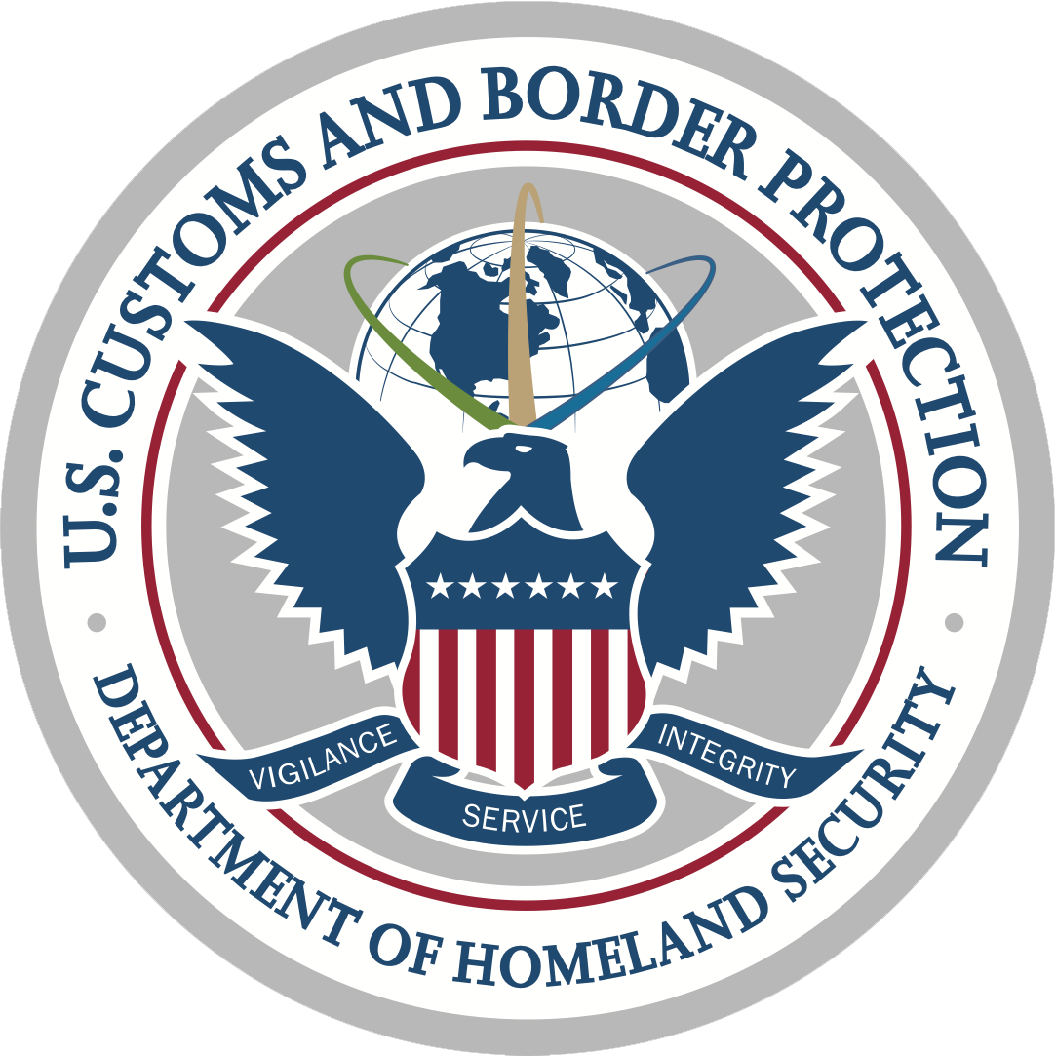
Executive Order 14411: Practical Impact on Brokers
Beginning on September 18, 2026, if CBP determines that an IOR or customs broker acting on behalf of an IOR has failed to provide complete and accurate information in CF-5106, CBP will void the IOR number, rendering it invalid for any purpose, including entering imported merchandise into the U.S.

Slide 42
Accuracy of Importer of Record Data Submitted to CBP
EO state: Customs brokers must exercise due diligence to ensure this information is accurate. Customs brokers should not transmit information to CBP that they know or should know is false or misleading, including unverified information.
Potential Consequences
  Increased CBP scrutiny
  Additional requests for supporting documentations
  Shipment delays and disruptions
  IOR number rendered invalid & inability to make entry
Notes:
CBP is placing greater emphasis on the accuracy and reliability of importer information. Brokers should have processes in place to validate key importer information before filing entries.

Slide 43
CBP – Oct. 8 NPRM on Low-Value Shipments
Proposed rule would amend CBP regulations to:
  Modify filing requirements for informal entries of goods valued at $2,500 or less
  Establish a new electronic informal entry type for merchandise entering through the mail environment.
  Require additional data elements for certain mail shipments
  Impose bonding requirements for certain informal entries
  Modify importer identification and entry processing requirements
CBP is proposing greater visibility into low-value import transactions and the parties participating in those transactions.
Comments are due by December 7.
Notes:
Reinforce CBP’s broader emphasis on importer verification, documentation and broker due diligence okay

Slide 44
Oct. 8 NPRM on LVS – Practical Impacts
Impact on Brokers:
  Certain low-value shipment transactions may involve consignees that are not the owner or purchaser of the merchandise
  The proposal contemplates circumstances in which a licensed customs broker may serve as the IOR
  Brokers may need to evaluate importer eligibility and RTME more closely in LVS transactions.
  Additional filing, data, and bonding requirements may increase compliance obligations.
  Supporting documentation and internal procedures will become increasingly important.
Notes:
CBP is proposing to amend 19 CFR 143.26(a) to require a consignee intending to
enter merchandise who is not an owner or purchaser (such as a foreign postal operator,
the United States Postal Service, a freight forwarder, or a carrier) to appoint a licensed
customs broker who will act as the importer of record for the entry of shipments valued at
$2,500 or less that are not covered by the exception in 19 CFR 143.26(b). This proposed
amendment makes it clear that the requirement for a broker to act as the importer of
record on behalf of a consignee, applicable to formally entered merchandise, would also
be applicable to the entry of merchandise valued at $2,500 or less which is entered via
entry type 11 or via the newly proposed electronic informal mail entry type 13, discussed
in more detail below. This proposed amendment was a requirement of the Entry Type 86
test. The requirements for entering shipments exempt from duty under 19 U.S.C.
1321(a)(2)(A)-(B) will remain unchanged from the current provisions in 19 CFR
143.26(b).
To file an entry type 13, a party with the right to make entry will have the option
to self-file the entry electronically in ACE or use a licensed broker. The right to make
entry, and thus to file an entry type 13, is limited to an owner or purchaser of the
merchandise being mailed to the United States, or a licensed broker properly appointed
by the owner, purchaser, or consignee. Under these proposed regulations, a consignee
must obtain the services of a licensed broker who will act as the importer of record for
the mail entry, consistent with the proposed requirements for informal entries in 19 CFR
143.26(a) detailed above

Slide 45
Due Diligence Requirements – 19 CFR § 11.29
Brokers must exercise due diligence in:
  Preparing and filing customs records
  Obtaining information from Clients
  Reviewing information provided to CBP
  Advising clients regarding customs requirements
  Maintaining procedures designed to promote compliance
Practical Applications
  Verify RTME before filing
  Verify POA validity
  Question inconsistent or incomplete information
  Maintain documentation supporting filing decisions

Slide 46
Best Practices
  Demonstrate competence. Keep abreast of regulations. Understand what it means to exercise reasonable care when filing entry.
  Understand your client’s business and products, especially when PGAs are involved.
  DOCUMENT!--maintain records supporting POA validity, written instruction from the IOR and support for RTME,
  Establish a knowledgeable single point of contact for when information is needed.
  Educate your clients on the requirements when needed. Make sure they understand the import process and potential liabilities.
  Immediately inform the importer of any customs inquiries or issues.
  Realize that many importers will throw you under the bus when an issue arises. Maintain records to show you acted reasonably and/or under their direction.

Slide 47



Thank
You!
Matthew Cummins
Member
Sandler, Travis & Rosenberg, P.A.
Phone: (713) 961-8027
Email: mcummins@strtrade.com
James Amyx
Member
Sandler, Travis & Rosenberg, P.A.
Phone: (713) 961-8025
Email: jamyx@strtrade.com

